Slide 1


Mason Flannery
June 29, 2023

Slide 2

Outline
Executive Summary
Introduction
Methodology
Results
Conclusion
Appendix

Slide 3
Executive Summary
This project sets out to predict if a given Falcon 9 first stage rocket will land successfully–without all the rocket science gobbledygook. With the dramatic decrease in cost largely due to the reusability of the rockets, we set out to determine the cost of the launch. To achieve this, we collected data from several reliable sources, thoroughly explored the data through descriptive EDA, prepared the data for analysis through feature engineering, and analyzed the data using advanced machine learning techniques, including support vector machines and decision tree classification. The results were finding a robust model that could predict if a given rocket would successfully land 84% of the time.

Slide 4
Introduction
Space travel, once a thing for only mega rich corporations and governments, has become something far more obtainable by individuals–with an average rocket costing about 165 million dollars each. However, through Elon Musk’s efforts with his company SpaceX, a trip to space can cost as low as 65 million dollars. The dramatic reduction in cost is largely tied to the reusability of Musk’s rockets. Thus, we set out to see if the rockets land consistently. If they don’t, then we expect alternate companies can still outbid SpaceX for a rocket launch.
In this project, we set out to solve the following problems:
Can we predict how often a SpaceX rocket will land successfully?
What are the best predictors of a successful landing?

Slide 5

Section 1

Slide 6
Methodology
Executive Summary
Data collection methodology:
Data was collected in 2 ways: web scraping and SpaceX’s REST API
Perform data wrangling
Data was processed using the pandas library
Perform exploratory data analysis (EDA) using visualization and SQL
Perform interactive visual analytics using Folium and Plotly Dash
Perform predictive analysis using classification models
Multiple models were thoroughly tested until the best was selected

Slide 7
Data Collection
The data was collected from the two following resources:
SpaceX’s official API
Web scraping Wikipedia data on launch details
Through combining these two resources we were able to gather sufficient data to accurately predict the landing state of the rockets

Slide 8
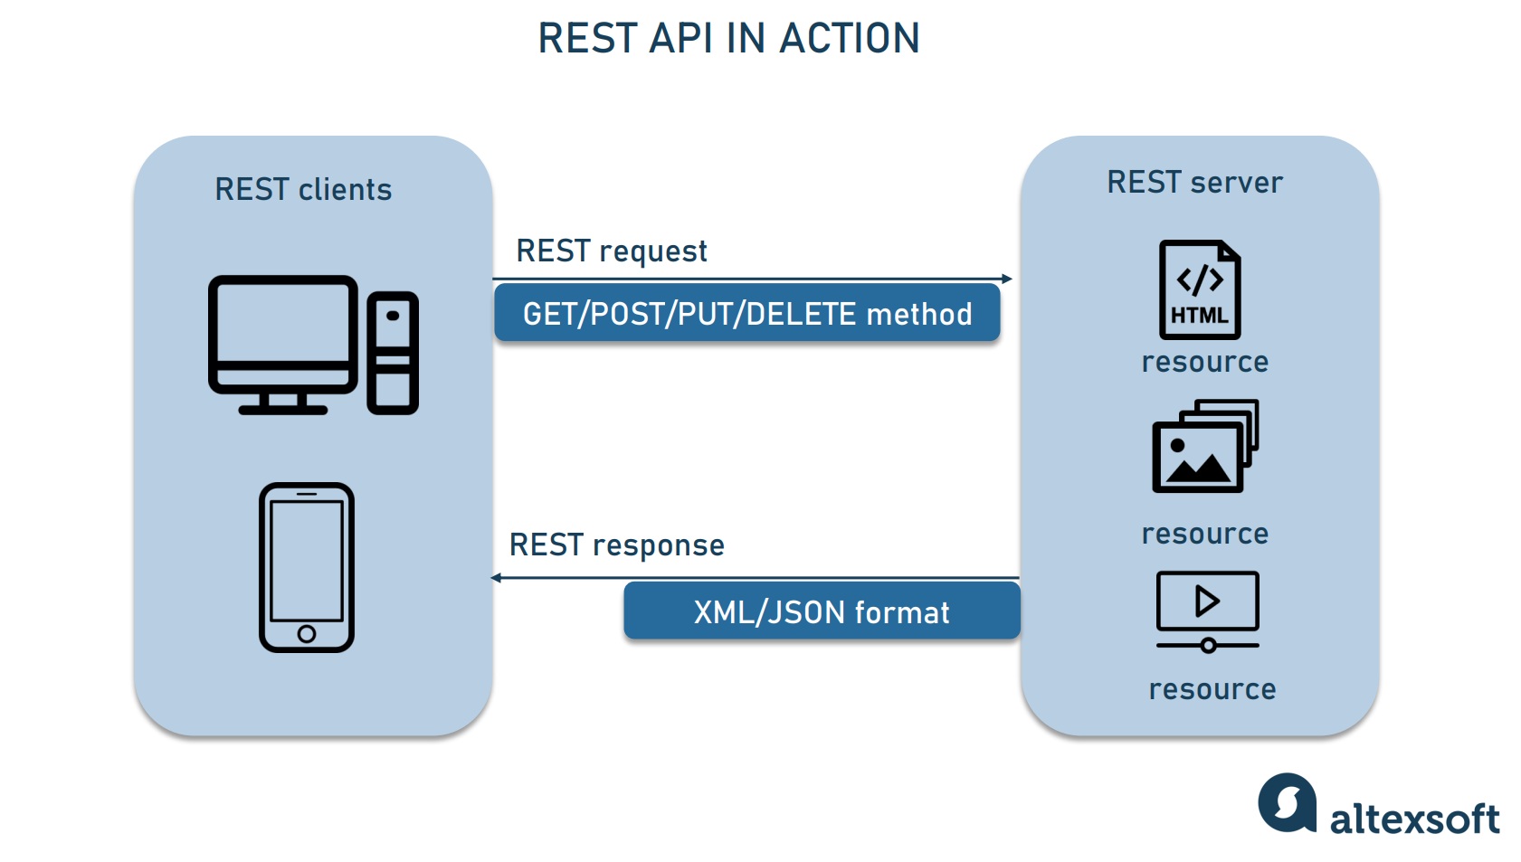
Data Collection – SpaceX API
Much of the data came from the SpaceX official API. This resource provided reliable data on every launch. The data was filtered for those pertaining to the Falcon 9 rockets, and more can be found on the specifics at the following link:
https://github.com/Ddotsam/IBM-Certification/blob/main/ds_capstone/work_books/collect-data-api.ipynb

Slide 9
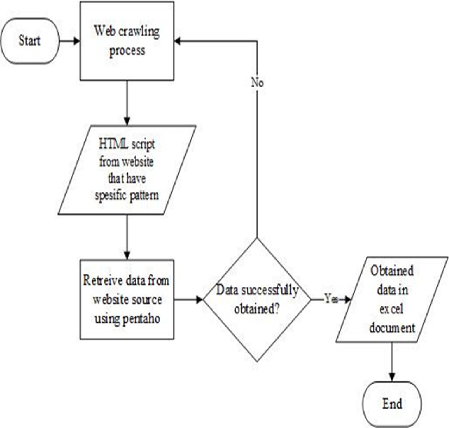
Data Collection - Scraping
Some data was also scraped from wikipedia using BeautifulSoup in Python. This data was rigorously searched to ensure validity, and it was found to be accurate in all ways pertaining to this project. More on the specific ifcs can be found at the link below:
https://github.com/Ddotsam/IBM-Certification/blob/main/ds_capstone/work_books/collect-data-webscrape.ipynb
Place your flowchart of web scraping here

Slide 10
Data Wrangling
In order to feed the data into the predictive models, the data must first be turned into a form that is conducive to machine learning. To do this, we thoroughly wrangled the data. This task included
Filtering for those tuples that were of interest
Organizing the data into vectorized objects using numpy and pandas in Python
Analyzing what data we had to ensure that there was sufficient
More can be found at the following link
https://github.com/Ddotsam/IBM-Certification/blob/main/ds_capstone/work_books/data-wrangling.ipynb

Slide 11
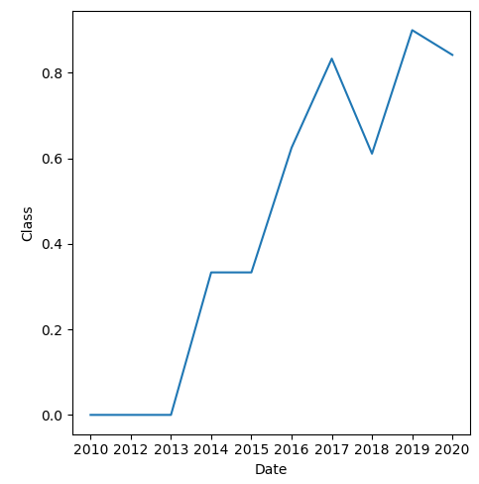
EDA with Data Visualization
To explore the data, many charts were built, scatter plots and line plots in particular. It was discovered that reusability increased with time, that is, as the years passes, SpaceX only got better at landing their rockets.
It was also discovered that certain orbits and launch sites were better at landing rockets, which suggests that decision tree classifiers or support vector machines would fit the data well.
More can be found at the following link
https://github.com/Ddotsam/IBM-Certification/blob/main/ds_capstone/work_books/EDA-mpl.ipynb

Slide 12

EDA with SQL
We also sought to understand the data in a tabular format using Structured Query Language (SQL).
This also put the data in a friendly format for relational use later
More can be found at the following link
https://github.com/Ddotsam/IBM-Certification/blob/main/ds_capstone/work_books/EDA-sql.ipynb

Slide 13
Build an Interactive Map with Folium
Though EDA with SQL, we discovered that the launch sites shared a one-to-many relationship with the landing sites. That is, every mission launched from just one site, but it could land at any given return site. Since some of these were on the ocean, we set out to map the launch sites and their class with where they launched and where they landed using the python package folium.
Interestingly, almost no relationship was found
More can be found at the link
https://github.com/Ddotsam/IBM-Certification/blob/main/ds_capstone/work_books/Analysis-folium.ipynb

Slide 14

Build a Dashboard with Plotly Dash
Using Plotly and Dash, we created an interactive dashboard web application to further explore the data.
We discovered insights on the success rate of various boosters when launched at various places. For example, FT version of the Falcon 9 Rocket was nearly always successful when launched from CCAFS LC-40
More can be found at the following link:
https://github.com/Ddotsam/IBM-Certification/blob/main/ds_capstone/work_books/Analysis-dashboard.py

Slide 15

Predictive Analysis (Classification)
Many models were tested to see which performed the best. We used many accuracy metrics, including F1 score, jaccard index, and log loss. Hyperparameter spaces were explored thoroughly using Grid Search methodologies.
more on the specifics can be found at the following link
https://github.com/Ddotsam/IBM-Certification/blob/main/ds_capstone/work_books/prediction-ML.ipynb

Slide 16
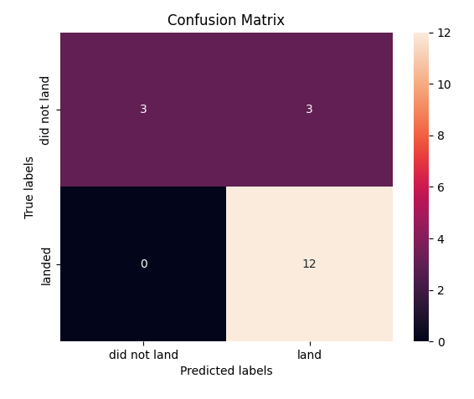
Results
In the end, we build a robust model that was able to predict the outcome of a given launch with 84% accuracy. This will help in the decision process of choosing a space travel provider

Slide 17

Section 2

Slide 18
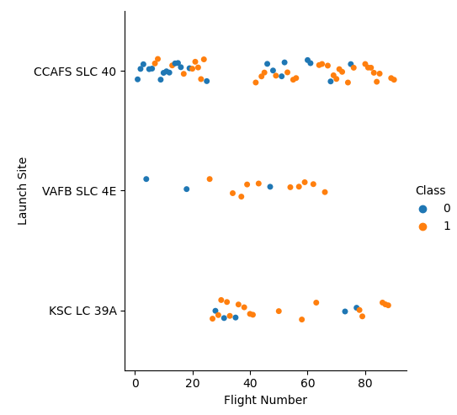
Flight Number vs. Launch Site
Show a scatter plot of Flight Number vs. Launch Site
Show the screenshot of the scatter plot with explanations
As you can see, the successful landings (orange dots) seem to be disconnected from the unsuccessful landings (blue dots) in many cases. This shows that machine learning algorithms that focus on euclidean separation such as decision trees or support vector machines could be suitable

Slide 19
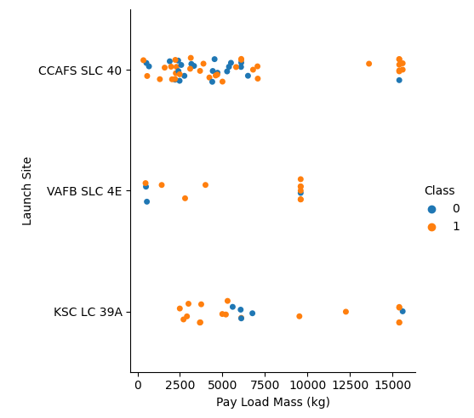
Payload vs. Launch Site
The vertical lines that seem to form in the launch site sections suggest that the launch sites have a maximum payload mass. Additionally, it seems that as we increase the mass, the likelihood of the rocket successfully landing increases
Show a scatter plot of Payload vs. Launch Site
Show the screenshot of the scatter plot with explanations

Slide 20
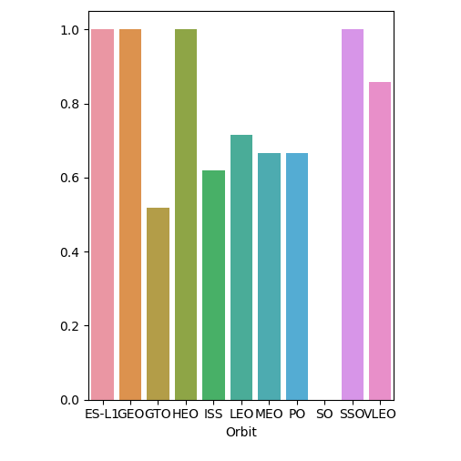
Success Rate vs. Orbit Type
here we see the success rate (bar height) plotted against the orbit type (x axis).
The orbit types GEO, SO, HEO, and ES-L1 all had only 1 launch, so their relative outstanding success and failure rates are to be taken with a grain of salt.
SSO orbits had multiple successful launches.
Show a bar chart for the success rate of each orbit type
Show the screenshot of the scatter plot with explanations

Slide 21
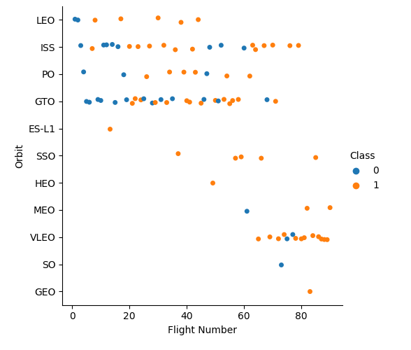
Flight Number vs. Orbit Type
Show a scatter point of Flight number vs. Orbit type
Show the screenshot of the scatter plot with explanations
As flight number increases, so does time. As you can see, landings were largely failures in the early stages of SpaceX, but outcomes have improved with time
Certain orbits tend to have troubles all throughout, while other orbits are better in general

Slide 22
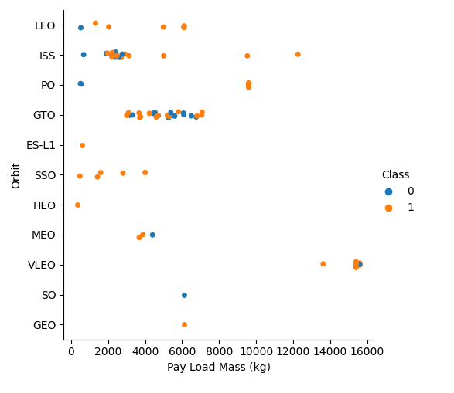
Payload vs. Orbit Type
Here is the payload mass (x-axis) plotted against the type of orbit (y-axis).
A similar trend of likelihood of a successful landing increasing with payload mass is shown, but this graph also shows that perhaps SpaceX is simply better at landing from certain orbit heights, regardless of payload mass
Show a scatter point of payload vs. orbit type
Show the screenshot of the scatter plot with explanations

Slide 23
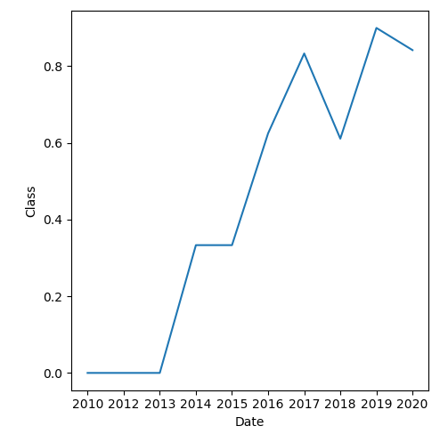
Launch Success Yearly Trend
As you can see, SpaceX has gotten better every year with landing their rockets.
comparing the success with other metrics, it seems that time is perhaps the best predictor of landing success
as time increases, we reliably predict a positive outcome.
as time decreases, we reliably predict a negative outcome
Show a line chart of yearly average success rate
Show the screenshot of the scatter plot with explanations

Slide 24
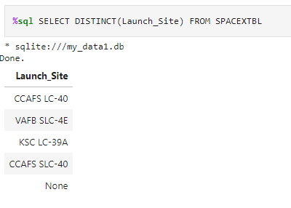
All Launch Site Names
these are the launch sites considered under this analysis
all Falcon 9 launches occurred at one of these sites.

Slide 25
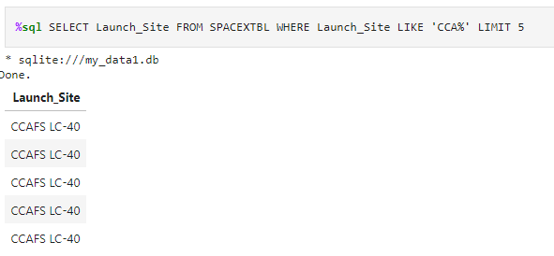
Launch Site Names Begin with 'CCA'
Here are 5 of the launches that took place at a site beginning with the string “CCA”

Slide 26
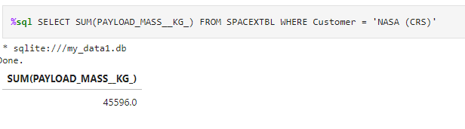
Total Payload Mass
The total payload mass in kilograms carried by SpaceX rockets for NASA was discovered to be 45596 kilograms

Slide 27
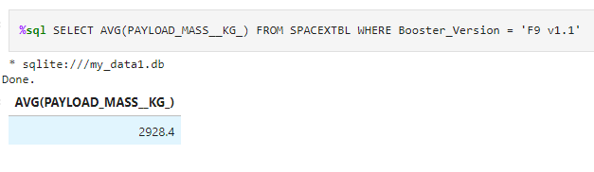
Average Payload Mass by F9 v1.1
The average payload mass in kilograms carried by Falcon 9 Rockets (Version 1.1 only) was discovered to be 2928.4 kilograms

Slide 28
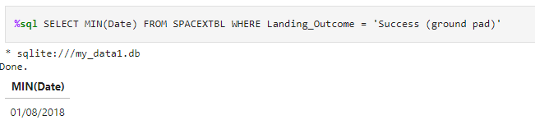
First Successful Ground Landing Date
The first successful landing on a ground pad took place on August 1st, 2018

Slide 29
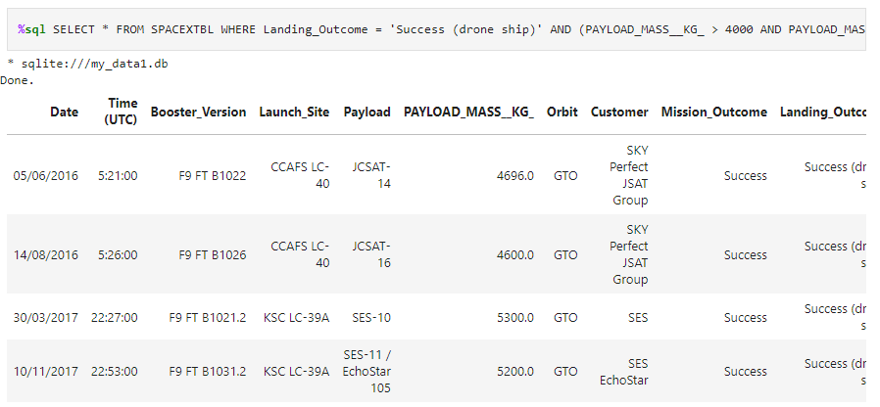
Successful Drone Ship Landing with Payload between 4000 and 6000
These are the only successful drone ship landings that had a payload between 4000 kilograms and 6000 kilograms

Slide 30
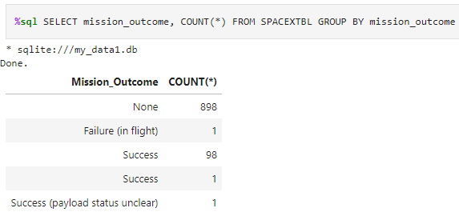
Total Number of Successful and Failure Mission Outcomes
Here are the number of successful and failure mission outcomes

Slide 31
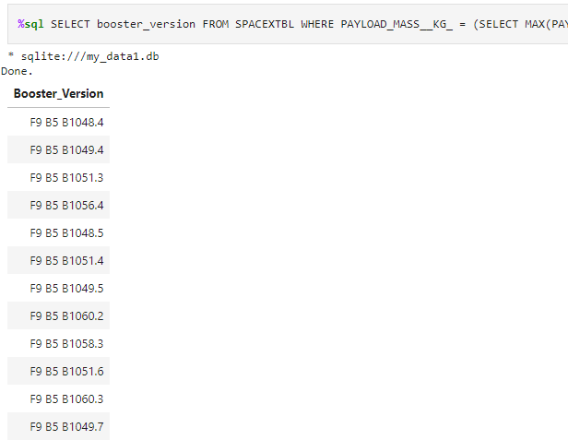
Boosters Carried Maximum Payload
These are the specific versions of the boosters that carried the maximum payload mass

Slide 32
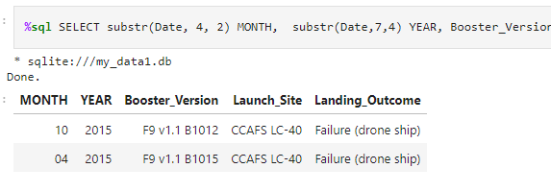
2015 Launch Records
These are all the launches that attempted to land on a drone ship in the year 2015.

Slide 33

Section 3

Slide 34
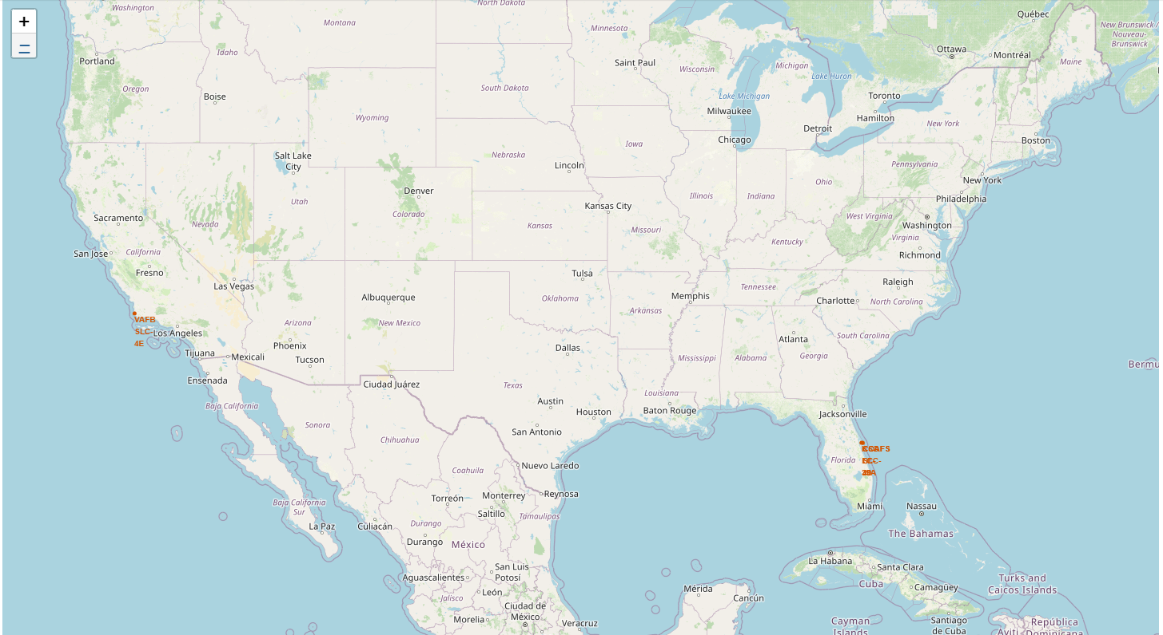
Map of Launch Sites
Here you can see the various launch sites that the Falcon 9 rockets launched from

Slide 35
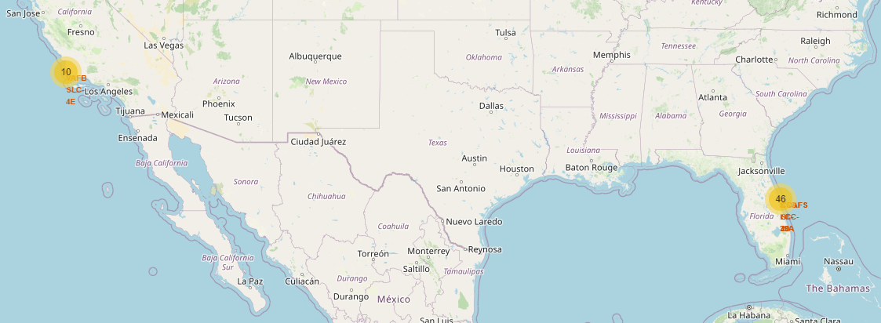
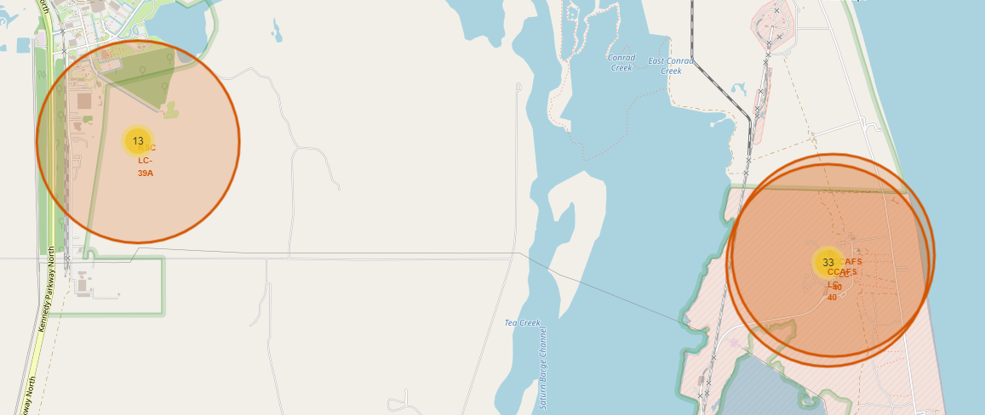
Grouped Launch Sites
Here, we grouped the launches onto the launch locations so that we could more easily see how the outcome was related to the launch location

Slide 36
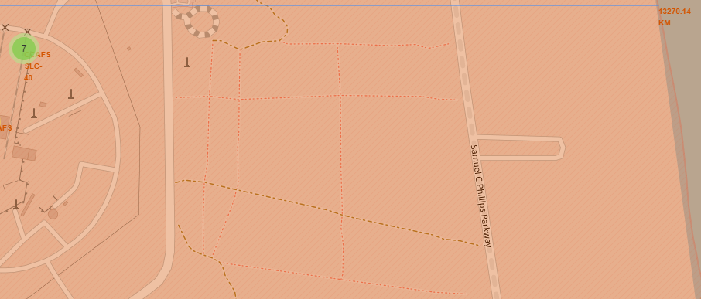
Distance from Shoreline
Finally, we colored the locations according to their success and failure rate, and then we found the distance from the nearest shore for one of the launch locations, as shown by the polyline annotation here

Slide 37

Section 4

Slide 38
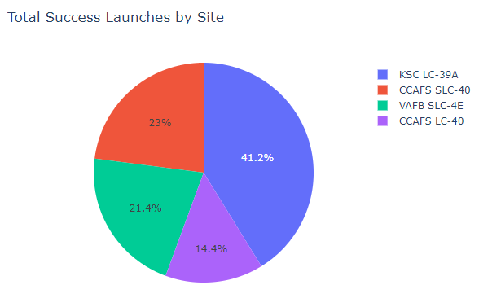
Total Success Rate by Site
Here, we see the success rate of various launch sites.
Clearly, the KSC LC-39A site has the largest success rate by nearly double when compared to all the other sites.

Slide 39
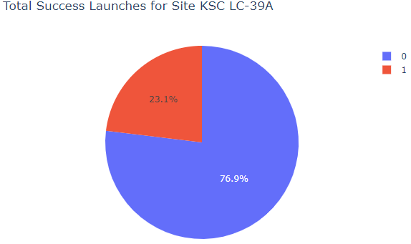
Most Successful Launch Site
Here is the breakdown for the launch site with the highest success rate
Clearly, launching from this site is probably the best bet as far as saving some money on launching rockets into space

Slide 40
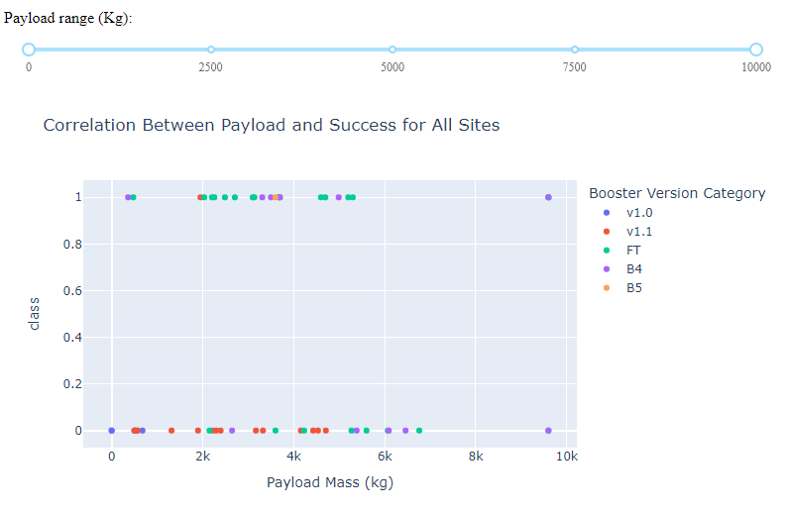
Payload Mass and Success Rate
This is a representation of the launches from all sites, the payload mass of each launch, and the success of each launch. The color of the dot indicates the specific booster version
As mentioned before the FT booster seems to be the most successful

Slide 41

Section 5

Slide 42
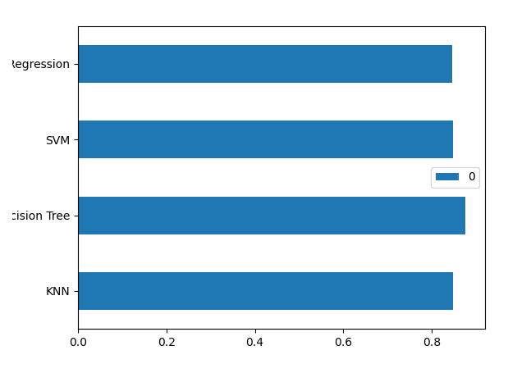
Classification Accuracy
Visualize the built model accuracy for all built classification models, in a bar chart
Find which model has the highest classification accuracy
Here, you can see that the Decision tree preformed the best out of all the other classification algorithms

Slide 43
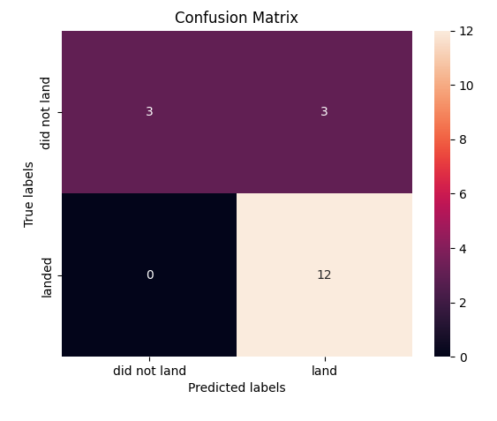
Confusion Matrix
Here is the confusion matrix of the Classification Tree.
It performed very well at correctly classifying successful flights, but it was just guessing that every flight would land successfully, which was not the case

Slide 44

Conclusions
From this we can see that the algorithm that performed the best on average is the one that simply guessed every flight would land successfully!
Especially considering what we know about how launches that occurred later in time are more likely to land successfully in general, this shows that we could trust SpaceX to offer the cheapest experience in space flight on average

Slide 45


